Slide 1
STOCK SELECTOR ML driven sector specific portfolio selector

Slide 2

"Rule No. 1 is never lose money. Rule No. 2 is never forget Rule No. 1.“
Warren Buffett

Slide 3
Table of Contents
Company Profile
Current Industry
Our Approach
Conclusions
Live Demo
Product Roadmap

Slide 4
Company Profile
1
Let’s start with the first set of slides

Slide 5

Roland Jennifer Ash

Slide 6
Current Industry
2

Slide 7
Fundamental vs. Technical Analysis
2
Technical Analysis
Technical analysis is primarily concerned with examining the historical security price movements. It is based on the underlying assumption that all known fundamentals are factored into the price. As such there is no attempt to measure a security's intrinsic value, rather to use stock charts to identify patterns and trends that suggest what the price will do in the future.
Fundamental Analysis
Fundamental analysis is a method of evaluating securities by attempting to measure the intrinsic value.
Fundamental analysts study everything from the overall economy and industry conditions to the financial condition and management of companies. Earnings, expenses, assets, and liabilities are all important characteristics to fundamental analysts.

Slide 8
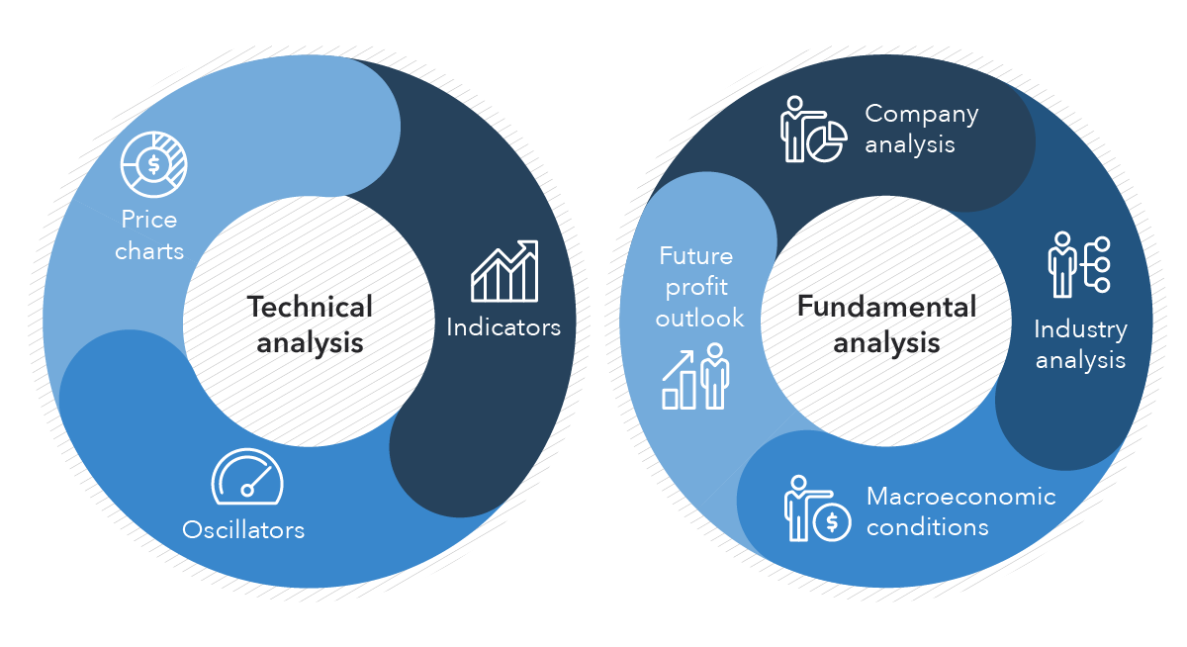
Fundamental vs. Technical Analysis
2

Slide 9
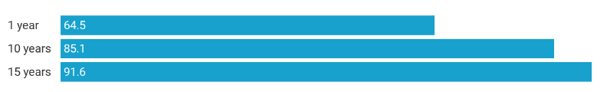
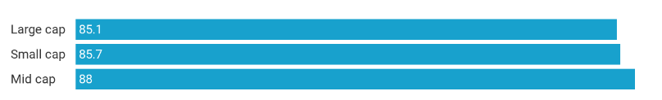
Active vs. Passive
2
According to the 2018 S&P Dow Jones Indices Annual Survey of Assets fund managers continue to trail their benchmarks.
The findings support the assertions of many financial advisors, who say that investing in low-cost, passive funds remains the soundest long-term investment.
% of Large Cap Funds That Underperformed the S&P 500
% of Fund Managers who Underperformed their Benchmarks (last 10 years)

Slide 10
Our Approach
3

Slide 11

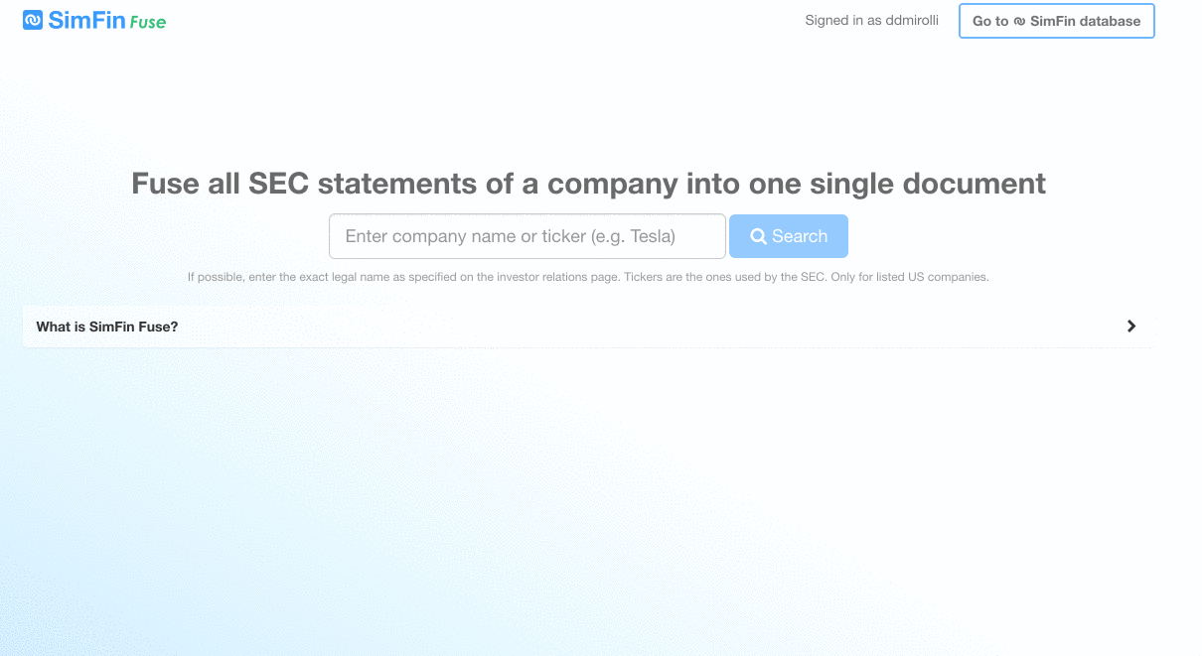
Data Collection
3
SimFin is an open-source, platform-agnostic, free database of fundamental data for ~2,600 publicly listed companies.
The key mission of SimFin is to break the nexus between access to detailed financial information and high service costs. In this way SimFin provides a valuable resource that democratizes access to financial data in a segment dominated by Bloomberg and CapIQ.
SimFin’s Python SDK allows users to easily pull in detailed financial data into a dataframe, including a comprehensive suite of fundamental trading signals.

Slide 12
Fundamental Signals
3
Financial Signals | Growth Signals | Valuation Signals
Current Ratio | Earnings Growth | Dividend Yield
Debt Ratio | Earnings Growth QOQ | Earnings Yield
Gross Profit Margin | Earnings Growth YOY | FCF Yield
Net Profit Margin | FCF Growth | Market-Cap
Return on Assets | FCF Growth QOQ | P/Book
Return on Equity | FCF Growth YOY | P/E
 | Sales Growth | P/FCF
 | Sales Growth QOQ | P/NCAV
 | Sales Growth YOY | P/NetNet
 |  | P/Sales

Slide 13
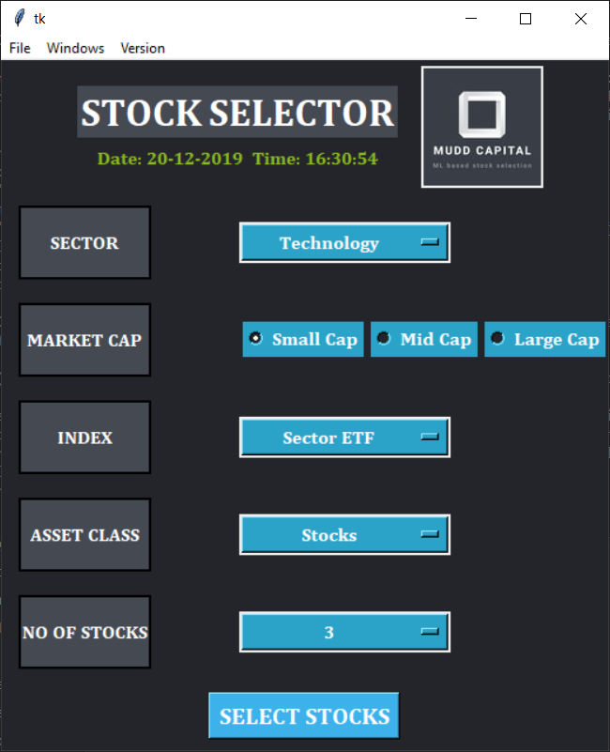
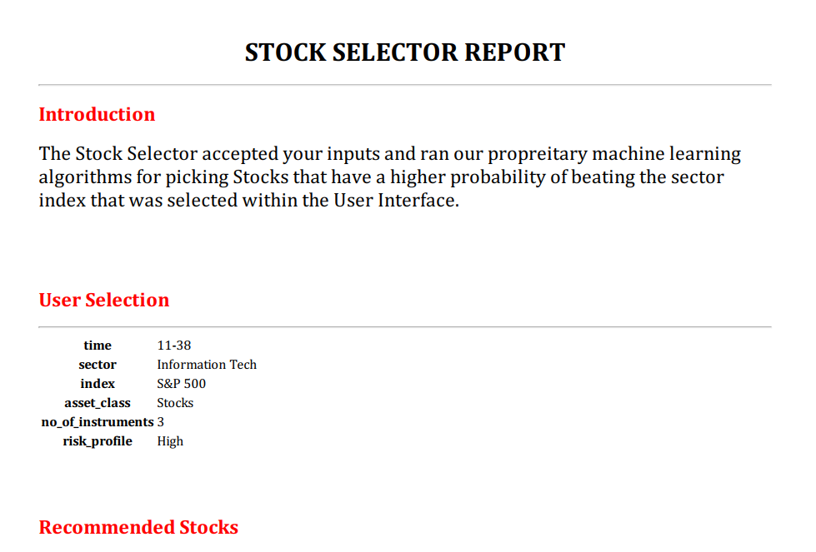
Product Design
3
The Stock Selector (SS) is built for analysts who want to do a quick discovery on stocks that have a higher probability of beating the index as well as investors who want to understand which stocks to invest in based on their requirements.
Users select the Sector, Market Cap, Index, Asset Class and Number of Stocks run the model. The algo will then run and produce a pdf report listing the selected stocks with a data summary for each.

Slide 14
Model Design
3
SimFin Fundamental Signal data forward filled to calendar year end with end of year price data.
Yearly return of Stocks v Index with a win defined as >= 5% out performance of the index.
Train on 2011 – 2018 data.
Test on 2019 data.

Slide 15
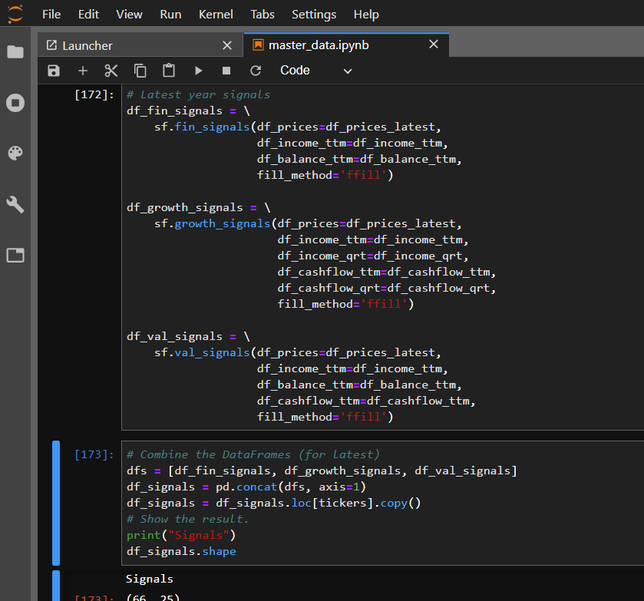
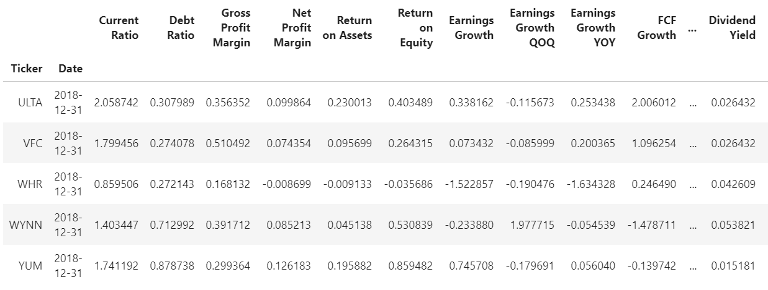
Model: SimFin Data
3

Slide 16
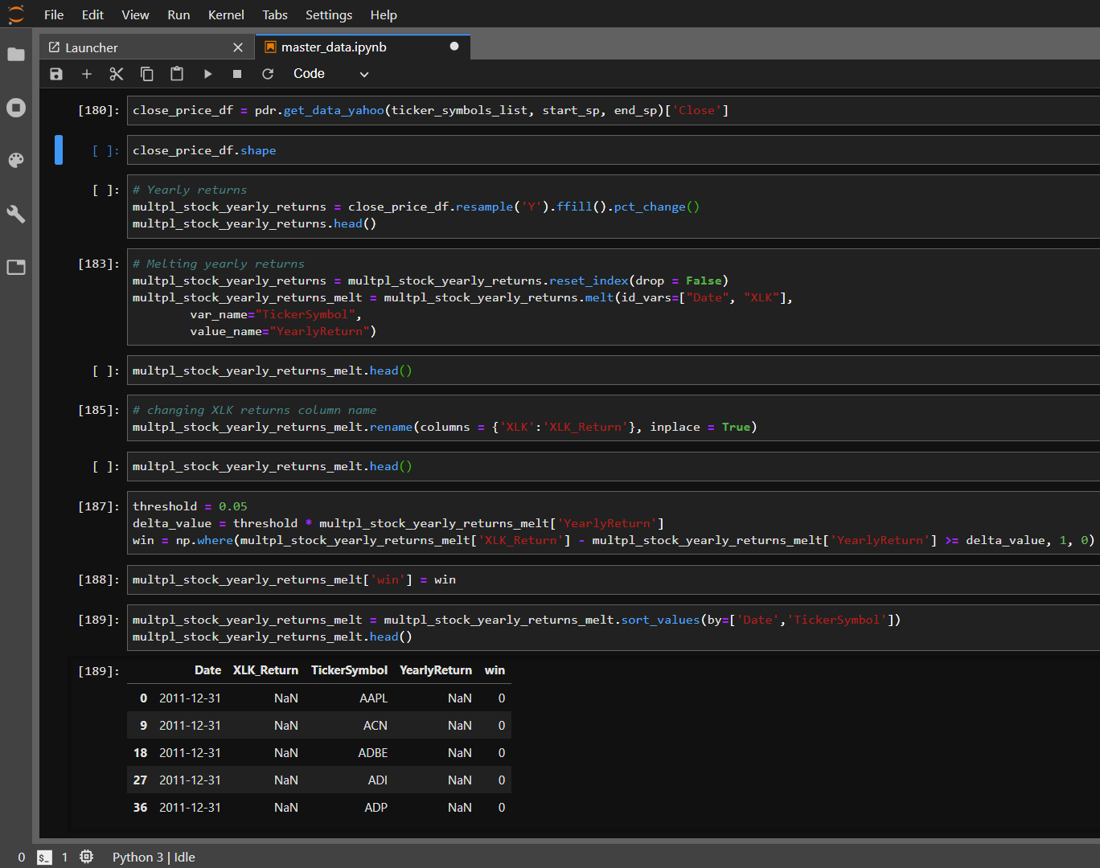
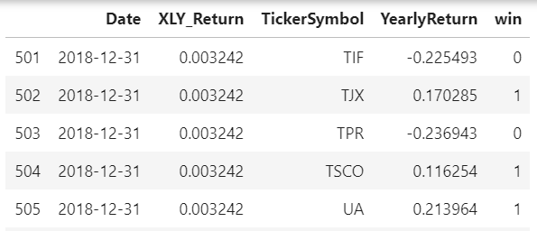
Model: Yahoo Finance Data
3

Slide 17
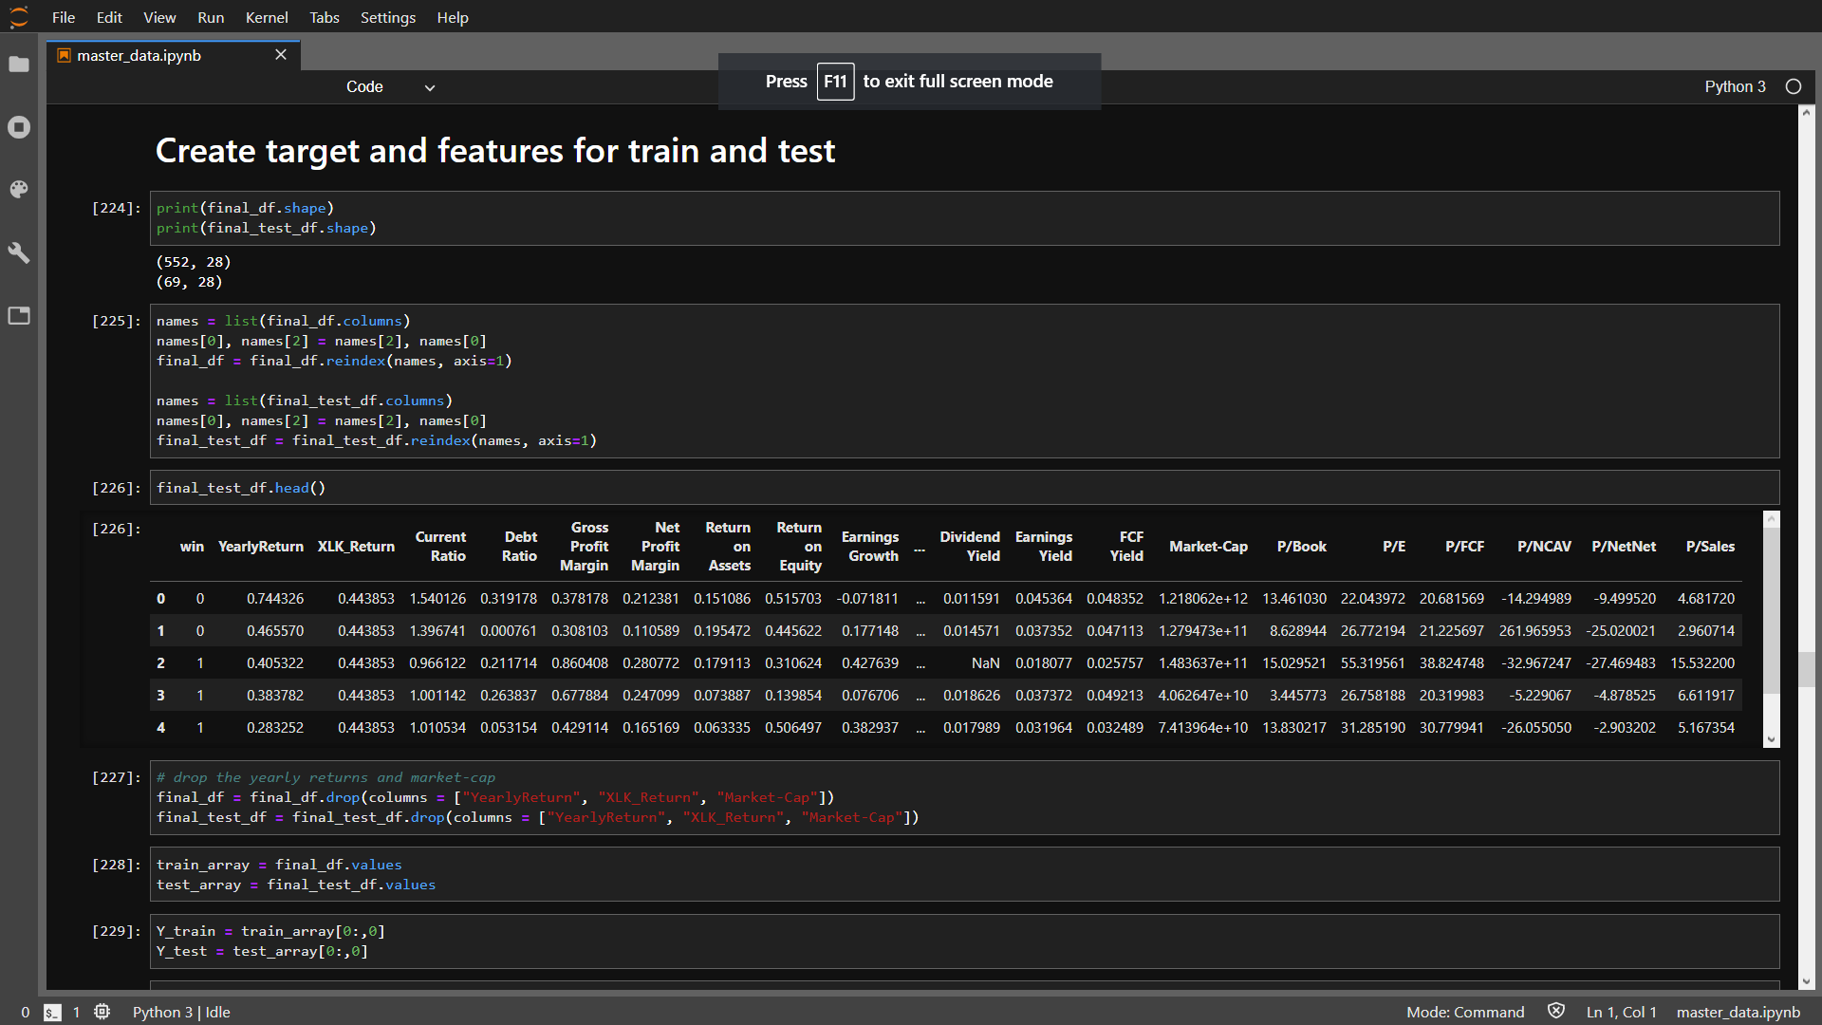
Model: Train & Test
3

Slide 18
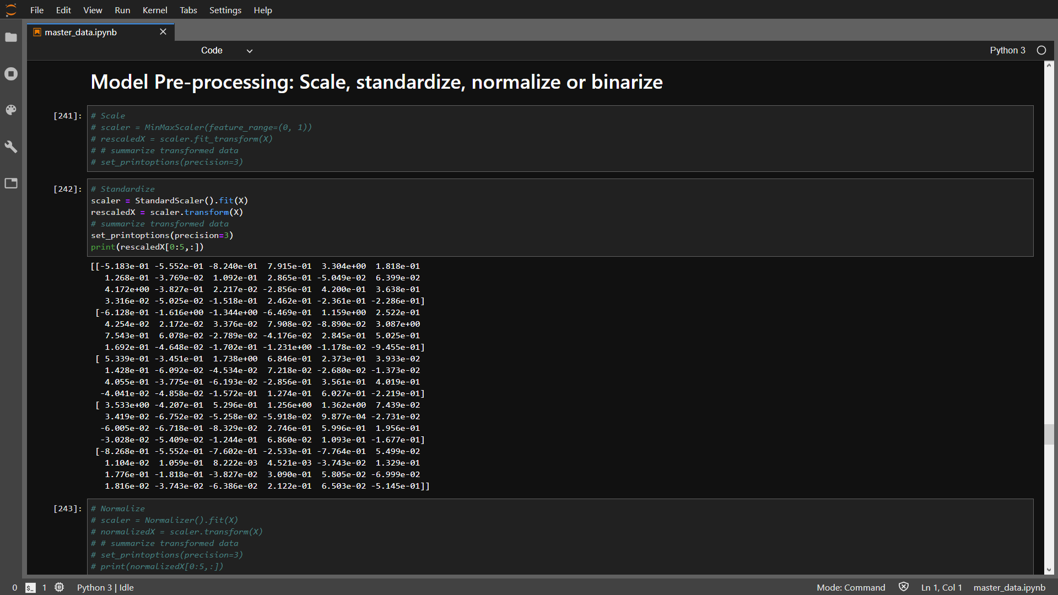
Model: Pre-processing
3

Slide 19
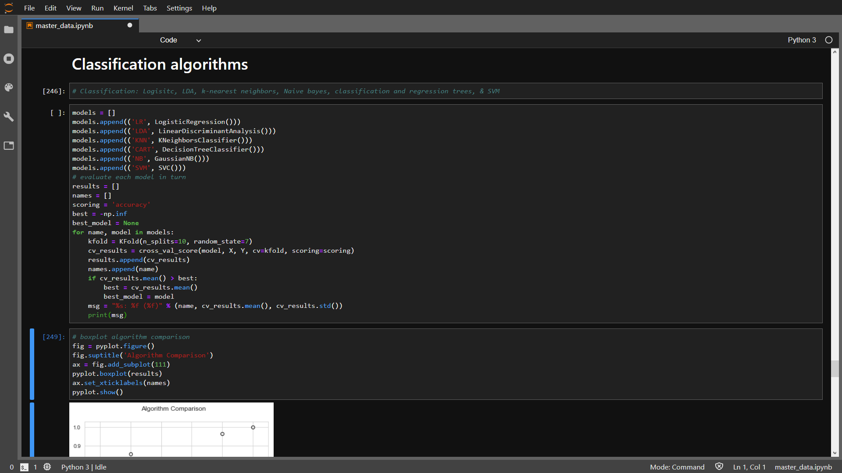
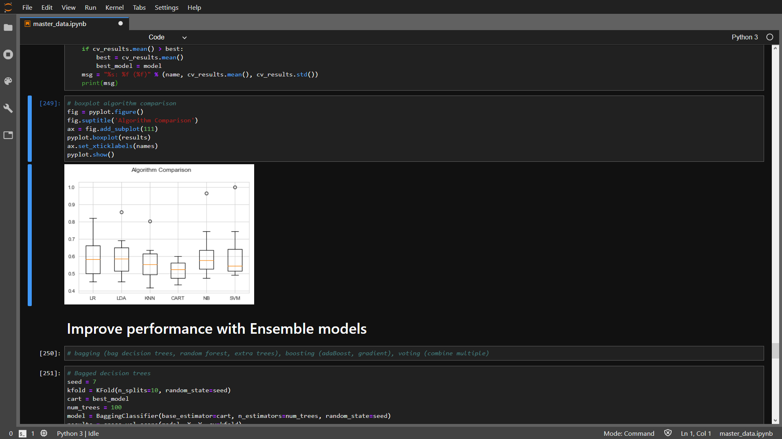
Model: Classification Algos
3

Slide 20
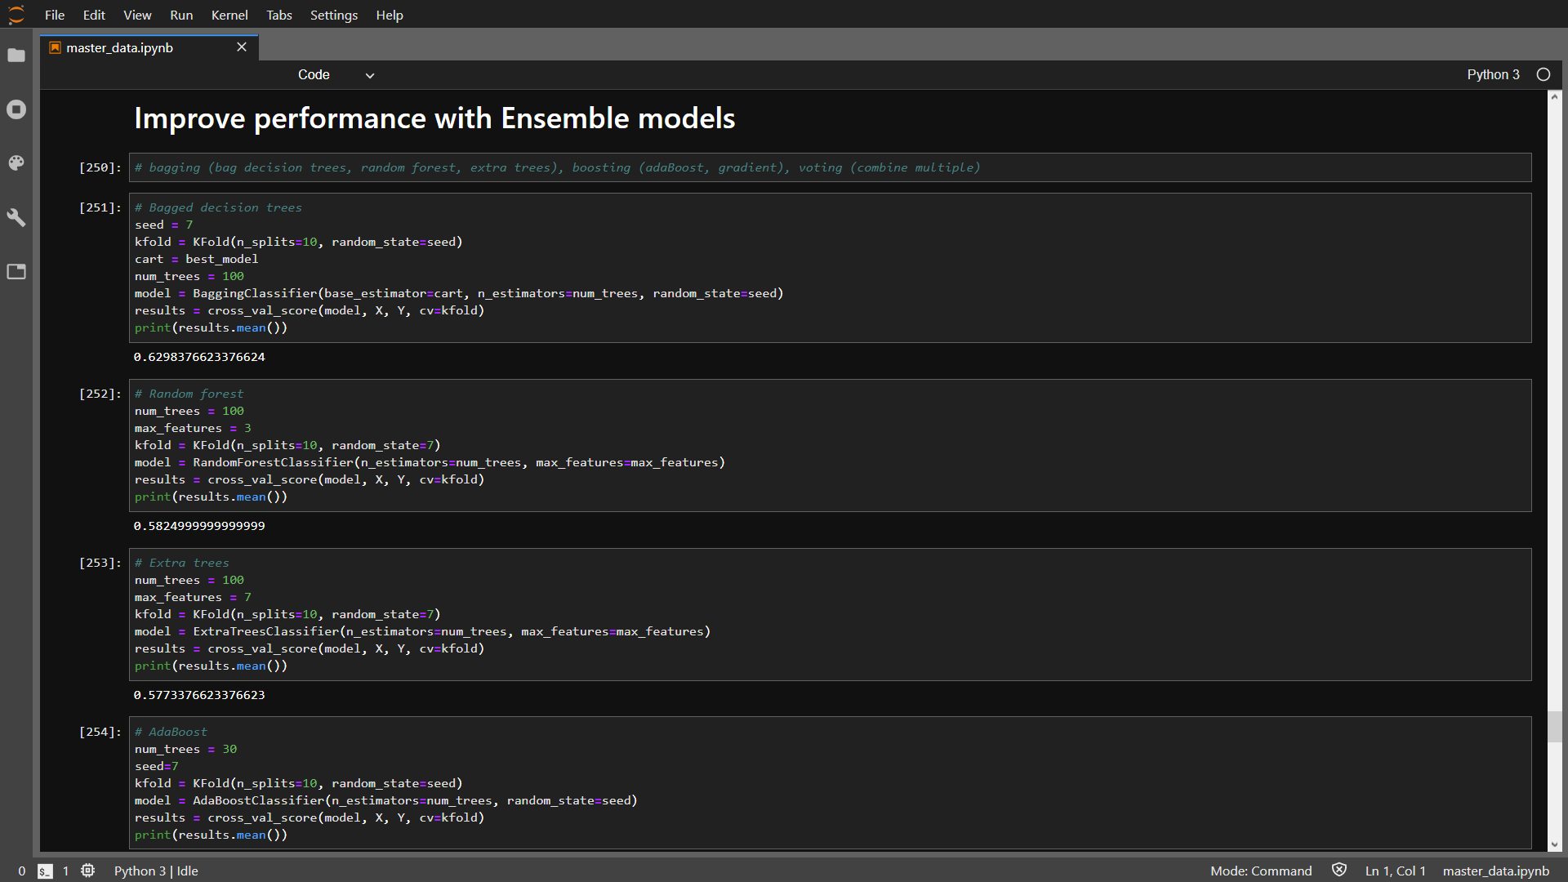
Model: Ensemble Models
3

Slide 21
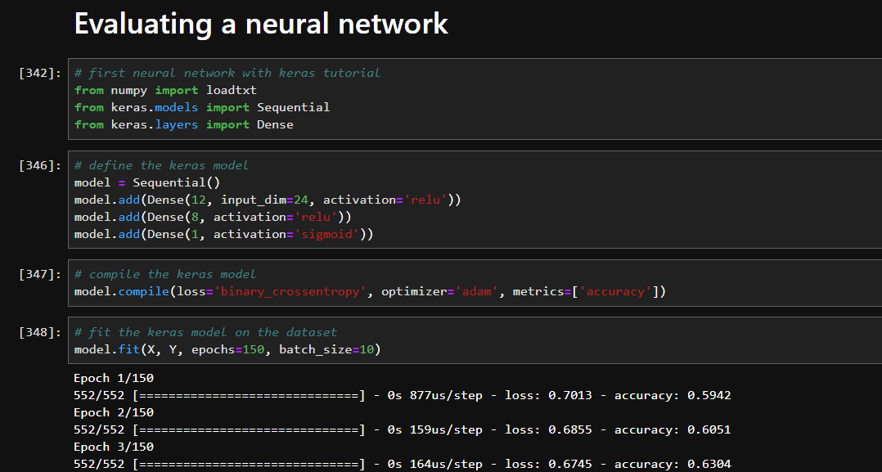
Model: Neural Network
3

Slide 22
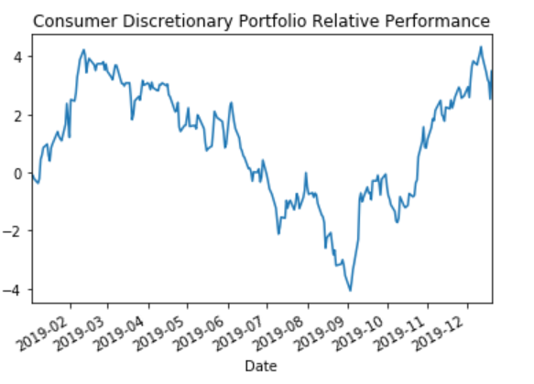
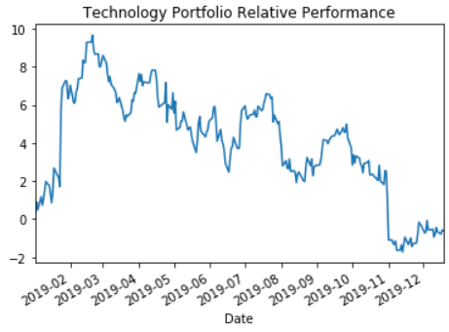
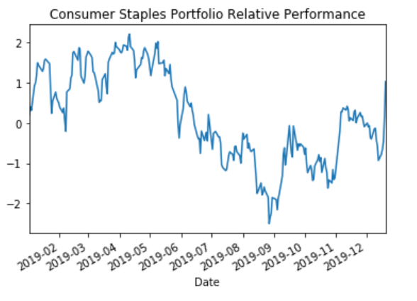
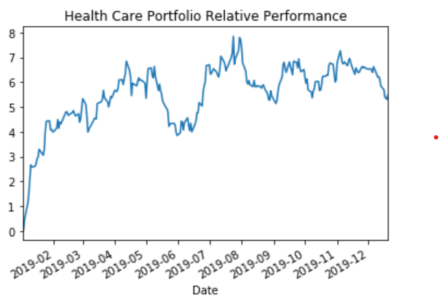
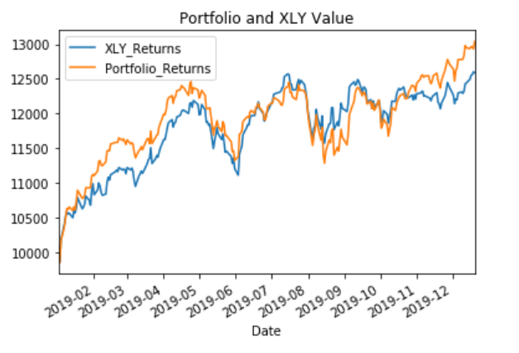
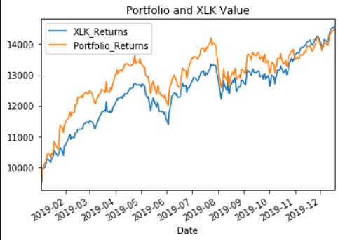
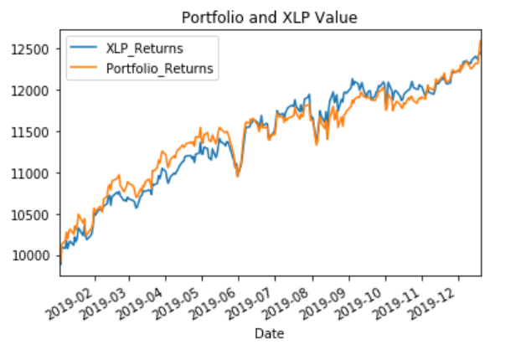
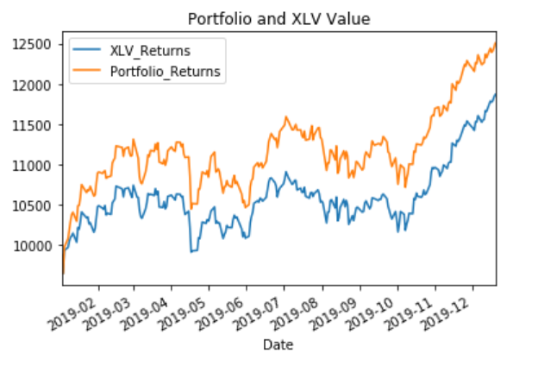
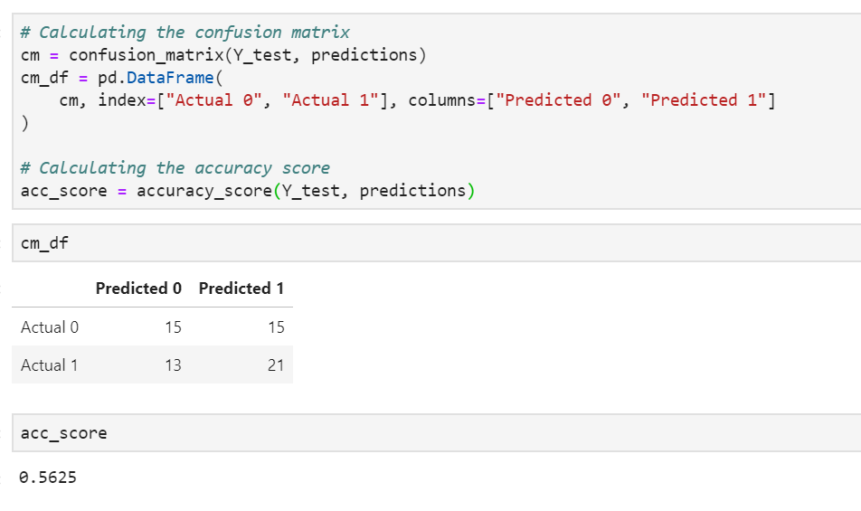
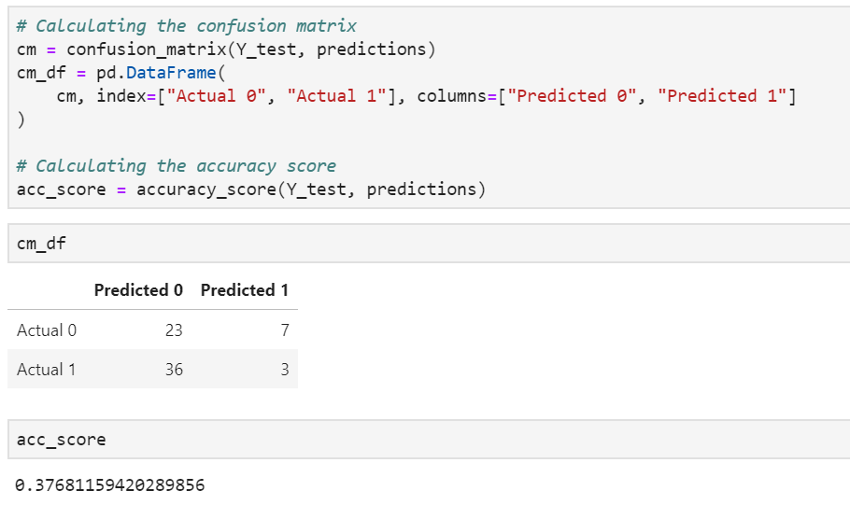
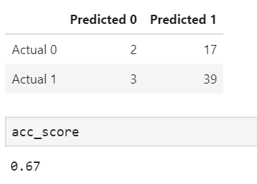
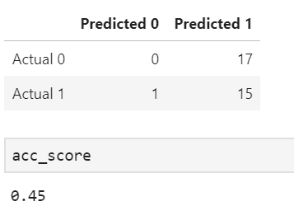
Conclusions
Consumer Discretionary (XLY) Technology (XLK) Consumer Staples (XLP) Health Care (XLV)
4

Slide 23
Live Demo
5

Slide 24
Product Roadmap
6
Version 1.0
Version 2.0
Version 3.0
Geo
US Only
US Only
US Only
Sector
Tech
Tech & Industrial
All Sectors
Asset Type
Stocks
Stocks
Stocks
Index
Index ETF
Index ETF & S&P 500
Index ETF & S&P 500

